Slide 1
Lesson Objectives
Define isotopes as atoms with the same number of protons and different numbers of neutrons. Explain the existence of isotopes in terms of the neutron content of the nucleus. Give examples of isotopes that have similar chemical properties but different physical properties, such as hydrogen, carbon and cobalt. Describe differences in physical properties of isotopes of the same element, such as hydrogen, carbon and cobalt. Predict the chemical behaviour of an isotope given the properties of another isotope of the same element.- THERE AREN’T ANY JUST IT CAN BE RADIOACTIVE (DETECTABLE) OR THE SLIGHTLY HEAVIER. Define relative atomic mass (atomic weight) as the ratio of the average mass of the atom to 1/12 the mass of an atom of 12-C. Explain the existence of fractional atomic masses of some elements in terms of the existence of naturally occurring isotopes. You now need to … Calculate the relative atomic mass given the isotopic mass and relative abundances of the isotopes of an element. Represent different isotopes in the form ^{A}X (IUPAC) or X-A. Calculate relative abundance of an isotope given relative atomic mass and abundance of other isotopes of an element. State and compare the characteristics of homogeneous and heterogeneous substances. Distinguish between pure substances (elements and compounds), homogeneous mixtures and heterogeneous mixtures. Explain the relationship between the identity and relative amounts of substances in a mixture and its properties.

Slide 2
Isotopes

Slide 3
A boron isotope has a relative mass of ~10 a.m.u.
Give the isotopic notation for one of its isotopes.

Slide 4
Discovery of isotopes by mass spectrometry
What is the difference in mass between the two isotopes of hydrogen ?
1 a.m.u.
= 1.7 × 10⁻²⁴ g
= 0.0000000000000000000000017 g
No balance is accurate enough to distinguish this difference

Slide 5
What is the difference in mass between the two isotopes of hydrogen ?
What is the relative abundances of the two isotopes of hydrogen ?
99.8% 0.02%
Both tasks can be accomplished with a mass spectrometer !!

Slide 6
Relative isotopic mass
The relative isotopic mass of a particular isotope of an element is the relative mass of one atom of that isotope on the ¹²C = 12.000 scale.

Slide 7
Relative molecular mass (RMM)
The relative molecular mass is the relative mass of a molecule on the carbon-12 scale.
Relative molecular mass can be determined by mass spectrometer directly.

Slide 8
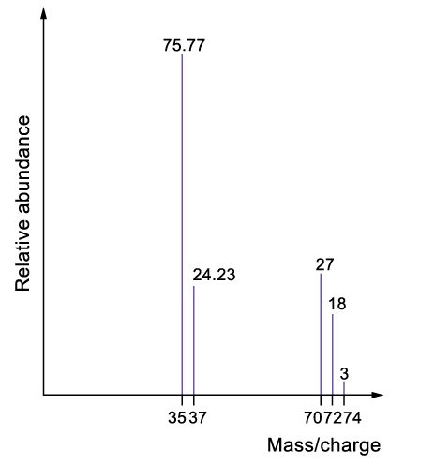
Mass spectrum of Cl₂:
The peaks with higher m/e ratio correspond to molecular ions
Fragmentation of molecules always occurs during the ionization process.
Cl₂(g) → Cl(g) + Cl(g)

Slide 9
Mass spectrum of Cl₂:
The scale has been enlarged for these two peaks.

Slide 10
Lesson Objectives
Define isotopes as atoms with the same number of protons and different numbers of neutrons. Explain the existence of isotopes in terms of the neutron content of the nucleus. Give examples of isotopes that have similar chemical properties but different physical properties, such as hydrogen, carbon and cobalt. Describe differences in physical properties of isotopes of the same element, such as hydrogen, carbon and cobalt. Predict the chemical behaviour of an isotope given the properties of another isotope of the same element.- THERE AREN’T ANY JUST IT CAN BE RADIOACTIVE (DETECTABLE) OR THE SLIGHTLY HEAVIER. Define relative atomic mass (atomic weight) as the ratio of the average mass of the atom to 1/12 the mass of an atom of 12-C. Explain the existence of fractional atomic masses of some elements in terms of the existence of naturally occurring isotopes. You now need to … Calculate the relative atomic mass given the isotopic mass and relative abundances of the isotopes of an element. Represent different isotopes in the form ^{A}X (IUPAC) or X-A. Calculate relative abundance of an isotope given relative atomic mass and abundance of other isotopes of an element. State and compare the characteristics of homogeneous and heterogeneous substances. Explain the relationship between the identity and relative amounts of substances in a mixture and its properties.

Slide 11
Complete the following table
m/e ratio | Corresponding ion
35
37
70
72
74
³⁵Cl⁺
³⁷Cl⁺
[³⁵Cl-³⁵Cl]⁺
[³⁵Cl-³⁷Cl]⁺
[³⁷Cl-³⁷Cl]⁺

Slide 12
What is the relative atomic mass of Cl?
The relative abundances of Cl-35 and Cl-37 are 75.77 and 24.23 respectively
= 35.48

Slide 13
What is the relative molecular mass of Cl₂ ?
Method 1
Method 2
= 71

Slide 14
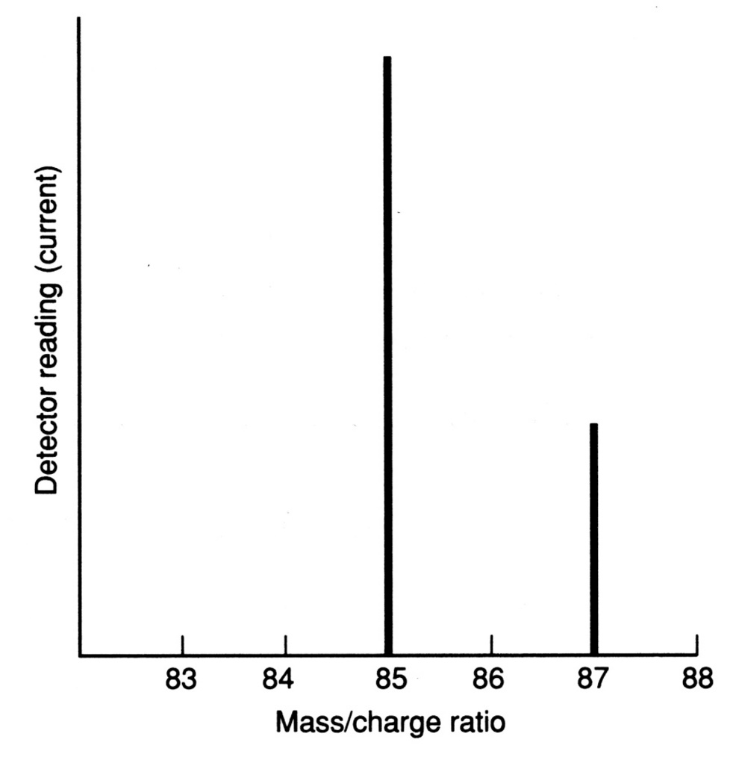
Mass spectrum of Rb:
Y-axis :-
Relative abundance,
Ion intensity, or
Detector current

Slide 15
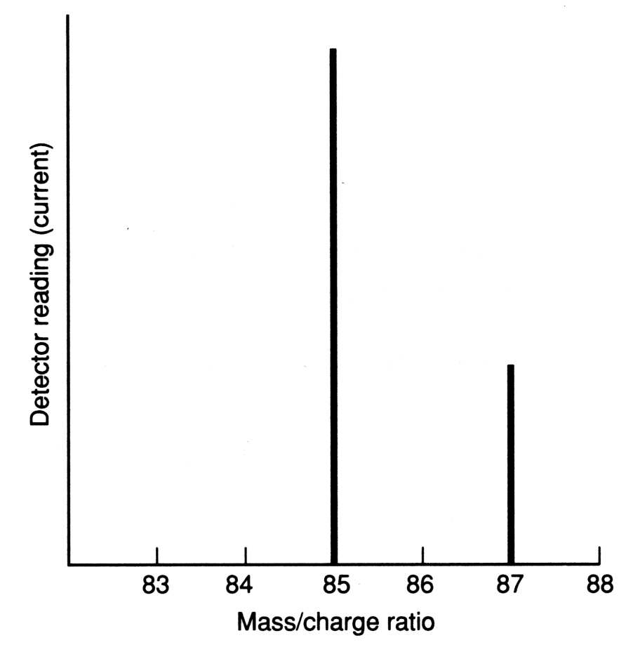
Q.1 Determine the relative atomic mass
72.12%
Relative atomic mass of Rb
= (85 × 72.12%) + (87 × 27.88%)
= 85.56
27.88%

Slide 16
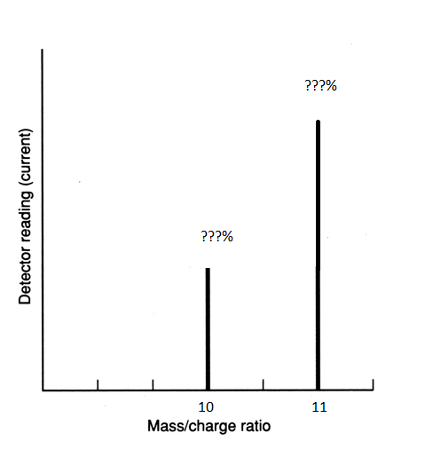
Q.2 Determine the relative abundancies from a relative atomic mass of two known isotopes.
Relative atomic mass of B = 10.8
Two isotopes ¹⁰B & ¹¹B.
Both isotopes have to account for 100% of all elements…
So let y be the unknown abundance:
10.8 = (10 x y) + (11 x (1-y))
10.8 = 10y + 11 – 11y
-0.2 = -y
y = 0.2 = 20% for isotope 10.
So… 80% for isotope 11.

Slide 17
Lesson Objectives
Define isotopes as atoms with the same number of protons and different numbers of neutrons. Explain the existence of isotopes in terms of the neutron content of the nucleus. Give examples of isotopes that have similar chemical properties but different physical properties, such as hydrogen, carbon and cobalt. Describe differences in physical properties of isotopes of the same element, such as hydrogen, carbon and cobalt. Predict the chemical behaviour of an isotope given the properties of another isotope of the same element.- THERE AREN’T ANY JUST IT CAN BE RADIOACTIVE (DETECTABLE) OR THE SLIGHTLY HEAVIER. Define relative atomic mass (atomic weight) as the ratio of the average mass of the atom to 1/12 the mass of an atom of 12-C. Explain the existence of fractional atomic masses of some elements in terms of the existence of naturally occurring isotopes. Having done examples of the next few objectives. You now need to … Calculate the relative atomic mass given the isotopic mass and relative abundances of the isotopes of an element. Represent different isotopes in the form ^{A}X (IUPAC) or X-A. Calculate relative abundance of an isotope given relative atomic mass and abundance of other isotopes of an element. State and compare the characteristics of homogeneous and heterogeneous substances. (DOING THIS LATER) Explain the relationship between the identity and relative amounts of substances in a mixture and its properties.

Slide 18
You can demonstrate this with…
Lucarelli Set 2 Q6-8, 11-16

